Slide 1
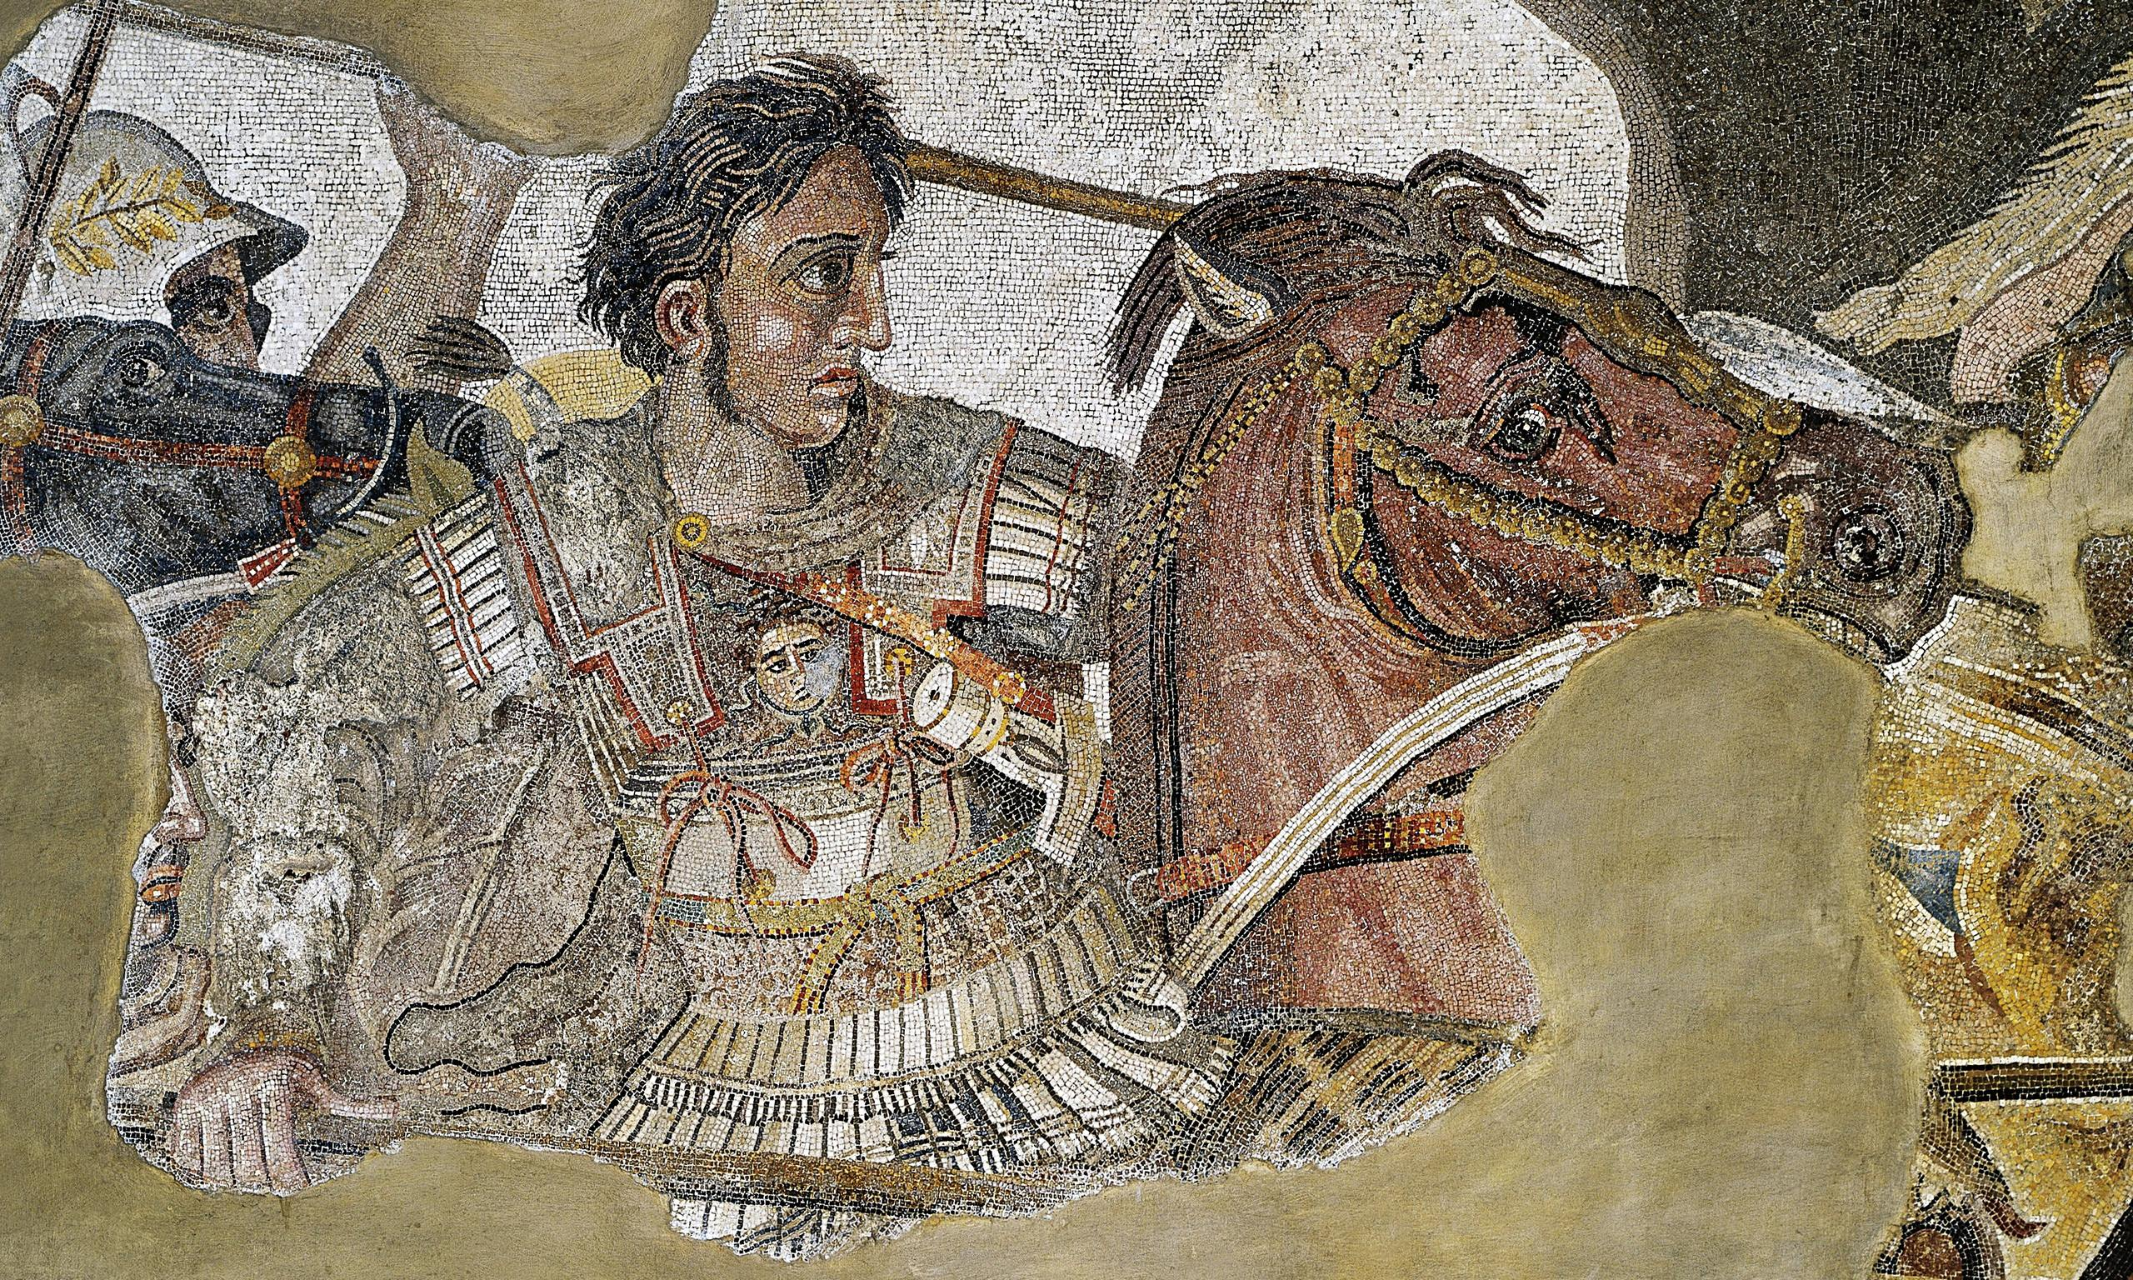
ATG - Review
Goal/s:
Review the BATTLES of ATG
Week 1 Lesson 4 – unit 2
Ms Barrie

Slide 2
Week 1 and 2 Overview
Selected individual Syllabus Points – Alexander the Great
the background of the selected individual, including: ▪ family background ▪ key events in their lives ▪ significant early influences
the career of the selected individual, including: ▪ change of role or status over time ▪ possible motivations for actions ▪ methods used to achieve aims
relationships with other individuals, groups, structures/institutions; for example, military or religious ▪ significant events in their career ▪ ways they shaped and/or changed their society ▪ the manner and impact of their death
challenges presented by other individuals, groups and structures/institutions
motivation and actions of the other individuals, groups and structures/institutions, seeking to influence
structures of power within the society
the legacy of the selected individual, including: ▪ assessment of their life and career ▪ the ways they shaped and/or changed their society ▪ their longer-term impact and legacy

Slide 3
Overview of ATG – Week 1 and 2
Tuesday | Wednesday | Thursday | Friday
Poster | ATG - Legacy | SUMMARY Early Life | SUMMARY Key Battles
SUMMARY Methods/Aims | SUMMARY Impacts | SUMMARY Challenges | SUMMARY Legacy

Slide 4
ATG’s Key Battles
Summary topic TWO

Slide 5
Class Discussion
What do you already know about ATG’s BATTLES?
Think about:
Key events
Military Strategies
Timeline
FILL IN YOUR MIND MAP

Slide 6
ACTIVITY – Create a Timeline of key events
Write the following:
Key Date
Who involved
Brief Summary
Use the laptops to research OR use your book
MUST COMPLETE SUMMARY ON BACK PAGE

